Slide 1
Software Testing
Integration Testing (Part 1)
Presented By
Ning Chen, Ph.D.
Professor
Department of Computer
Science
California State University,
Fullerton
© Ning Chen, 2017
*

Slide 2
Module Objectives
This module focuses on the Integration Testing

Slide 3
Motivation
Levels of testing
  Unit testing
  Integration testing (or component level testing)
  …
To make testing more efficient and to detect problems as early as possible, there is no need to wait for the finish of all units.

Slide 4
Planning
Let’s consider a scenario. As a tester, you know that there are several units of software are under unit testing now and in the next two weeks, you will have some units on hand for the integration testing. Most testers at this point probably are eager to study the interface requirements of those units and try to figure out test cases for them. Well, it turns out that this is not the top priority.

Slide 5
Then, what is the top priority?
Once you realize that the arrival timing of those units actually is an important factor that may affect your testing time and budge, you may ask a logical question on the what question (i.e., what should I do?).

Slide 6
Top-Down
Top-Down Structural Decomposition-Based Integration Testing
If the units arrive in a top-down fashion, then, sure enough, we will find a way to deal with it and we call our way as Top-Down Structural Decomposition-Based Integration Testing. Yes, it is an awkward long name. But, in an effort to avoid subtle confusion, let’s just at least use this long name once.

Slide 7
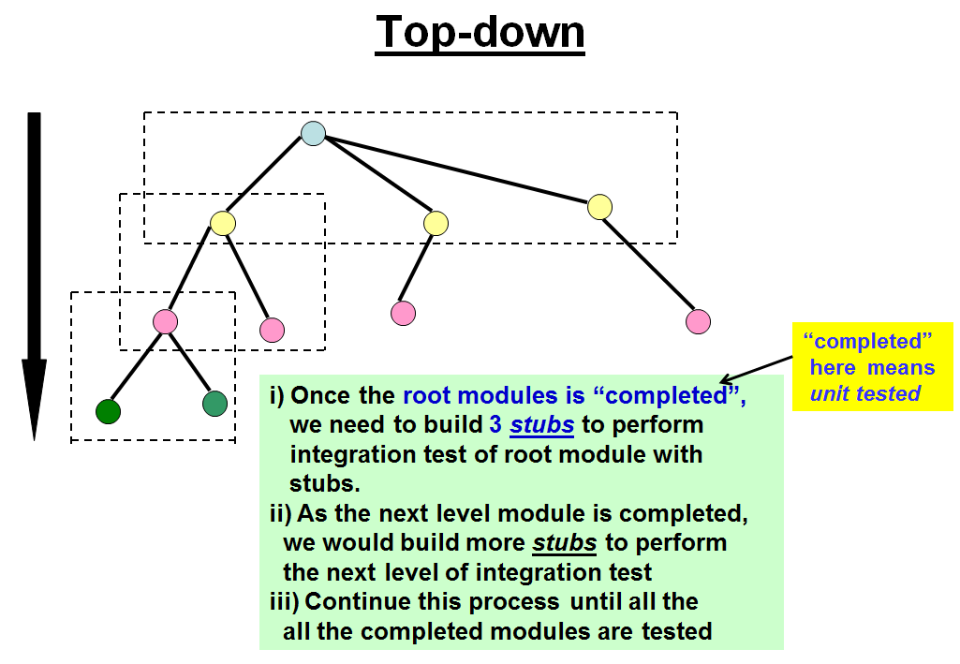
Top-Down

Slide 8
Test Stub
Once the root unit (or called module, if you like) arrives, you may want to construct three test stubs① so that you can test the root unit immediately.
①Test stubs are programs that simulate the behaviors of software components (or modules) that a module undergoing tests depends on.

Slide 9
Decomposition-Based
It is important to understand that the edge in the above Structural Graph may or MAY NOT represent calling relationship. We use an edge to link one unit to another unit may simply because the second unit logically falls under the hierarchy of the first unit (for example, the second unit resides in a sub-directory of the first unit). The first unit may not have any direct calls to the second unit.

Slide 10
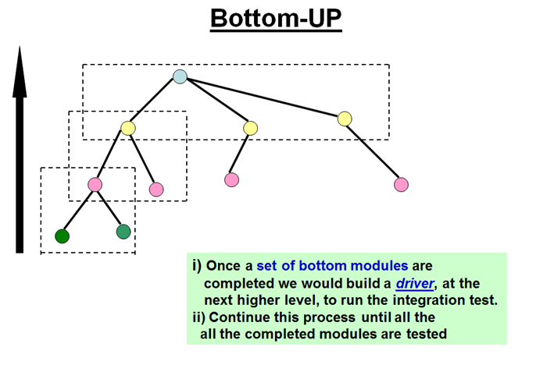
Bottom-Up
Bottom-Up Structural Decomposition-Based Integration Testing

Slide 11
Combination/Sandwich
Combination/Sandwich Structural Decomposition-Based Integration Testing

Slide 12
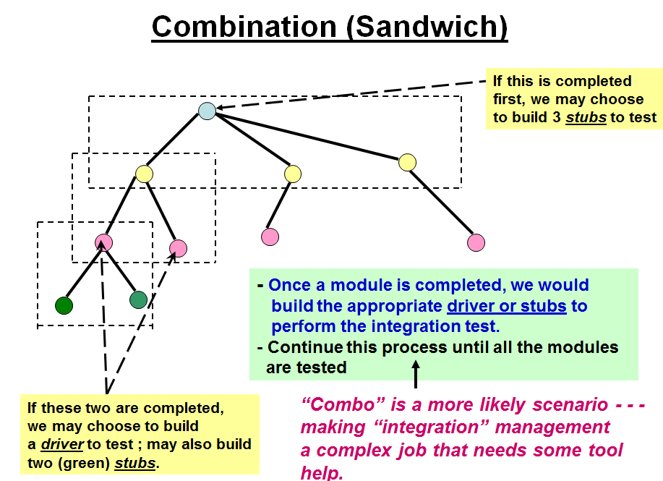
Combination/Sandwich

Slide 13
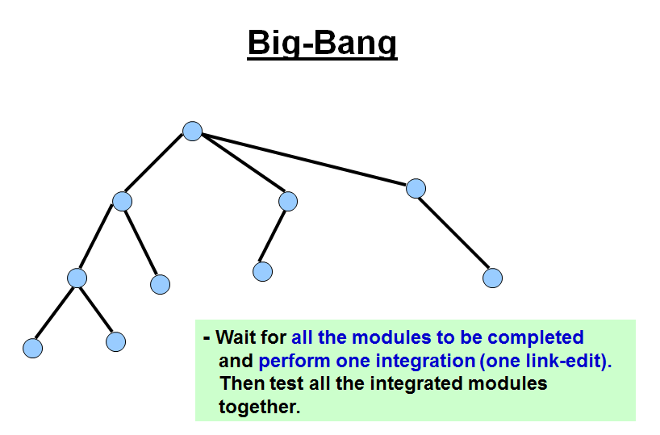
Big-Bang
Big-Bang Structural Decomposition-Based Integration Testing

Slide 14
Metrics
Some Metrics for Integration Test based on Structural Decomposition
For Top-down approach with n nodes, there is a potential need to construct as much as (n-1) stubs.
For Bottom-up approach with n nodes and v leaves, there is a potential need to construct as much as (n - v) drivers.
For both cases there may be as much as (n – v + edges) number of test sessions (e.g. cases or scenarios)

Slide 15
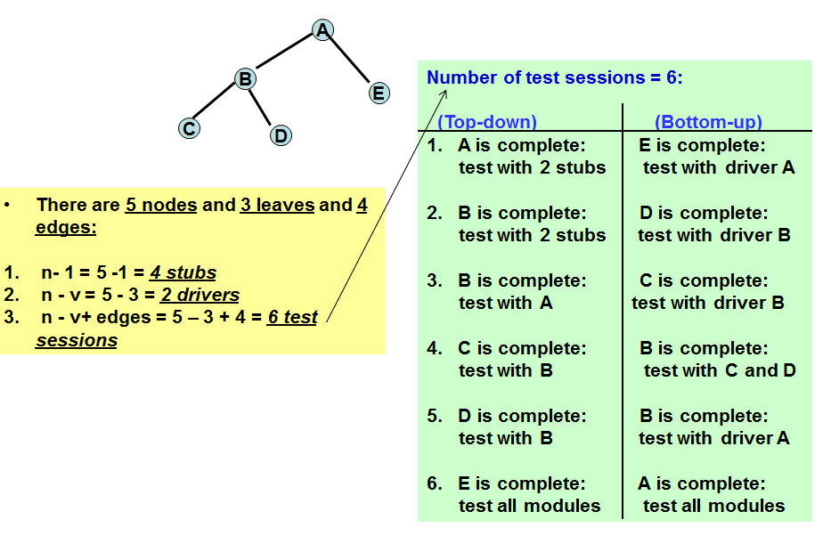
Metrics

